Slide 1
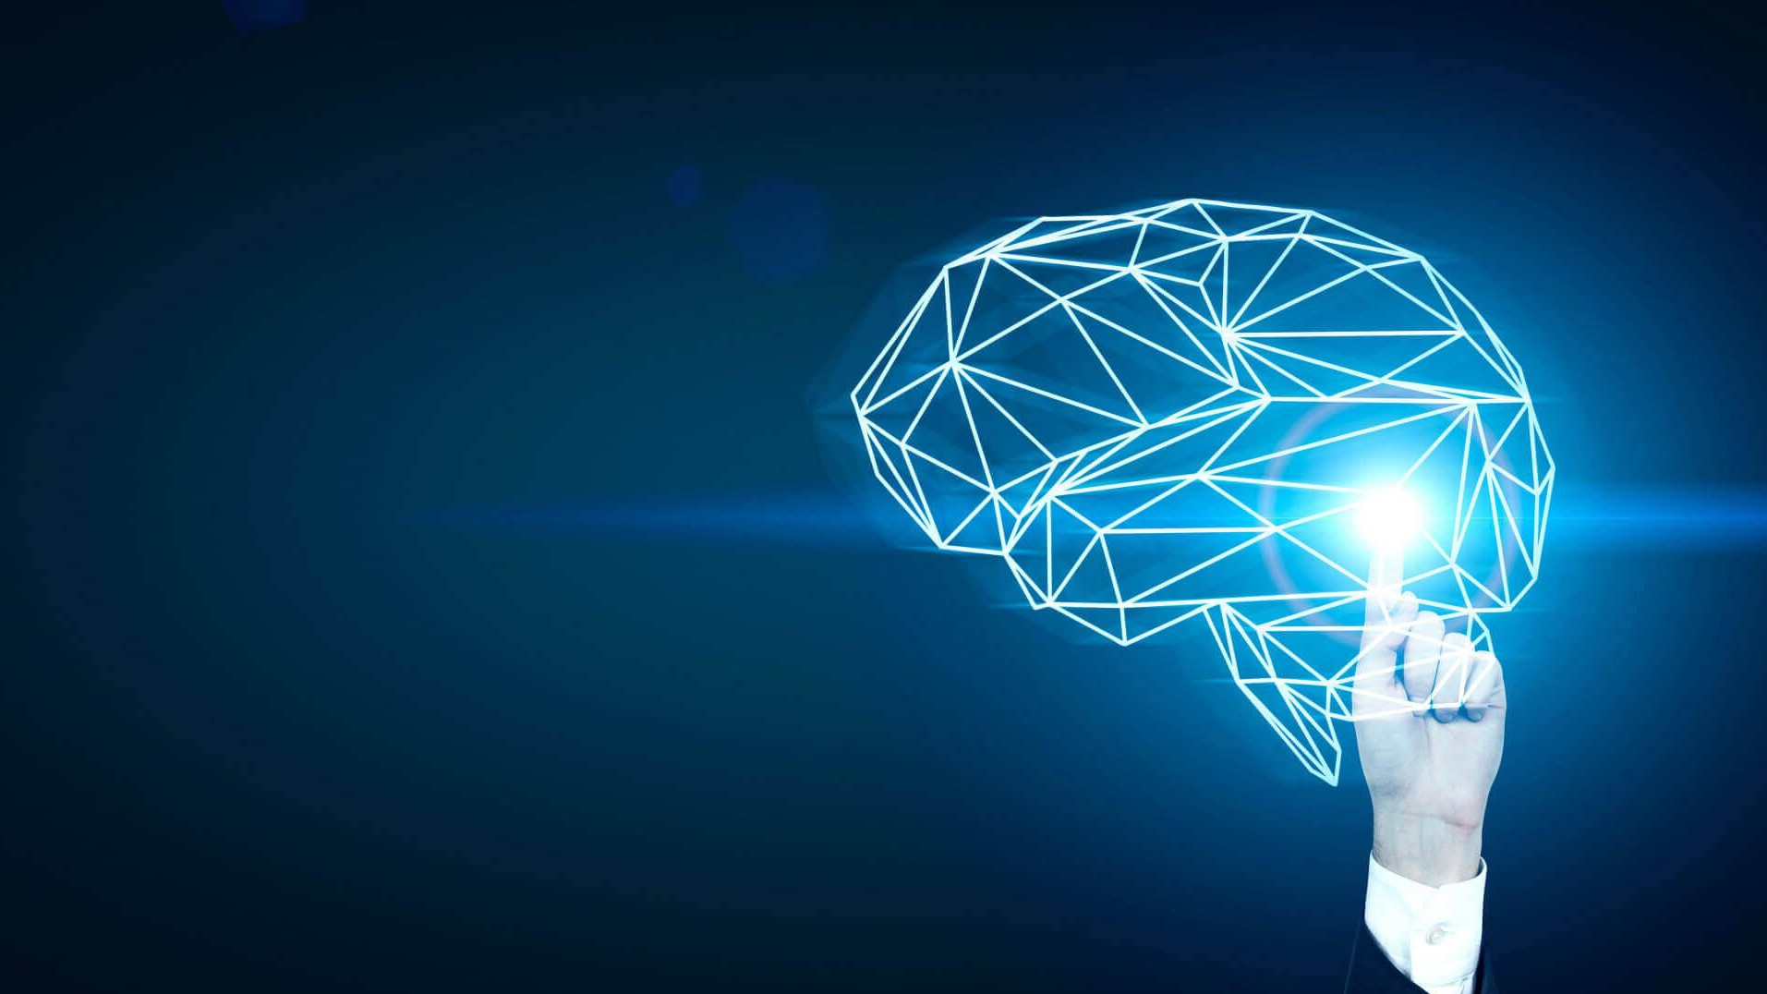
The Fundamentals of
Machine Learning
Soumedhik Bharati
Soumedhik Bharati- soumedhikbharati@gmail.com- 1

Slide 2
What Is Artificial Intelligence?
Artificial intelligence (AI) is an area of computer science that emphasizes the creation of intelligent machines that work and react like humans.
AI is an interdisciplinary science with multiple approaches.
AI has become an essential part of the technology industry.
Soumedhik Bharati- soumedhikbharati@gmail.com-

Slide 3
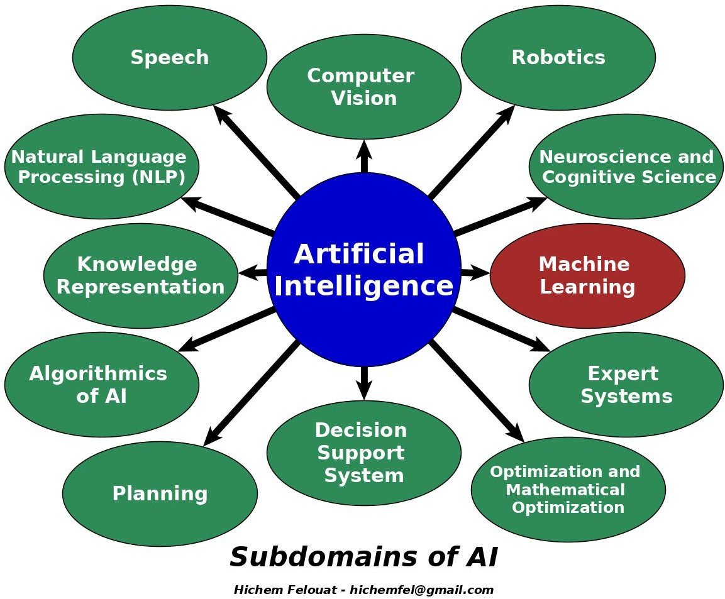
Subdomains of Artificial Intelligence
Soumedhik Bharati- soumedhikbharati@gmail.com-

Slide 4

What Is Machine Learning?
Machine Learning is the science (and art) of programming computers so they can learn from data.
Machine Learning is the field of study that gives computers the ability to learn without being explicitly programmed. —Arthur Samuel, 1959
Soumedhik Bharati- soumedhikbharati@gmail.com-

Slide 5
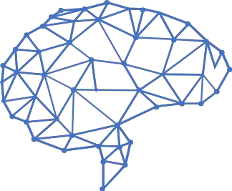
What Does Learning Mean?
A computer program is said to learn f rom experience E with respect to some task T and some performance measure P, i f i ts performance on T, as measured by P, improves with experience E. — Tom Mitchell, 1997
Soumedhik Bharati- soumedhikbharati@gmail.com-

Slide 6
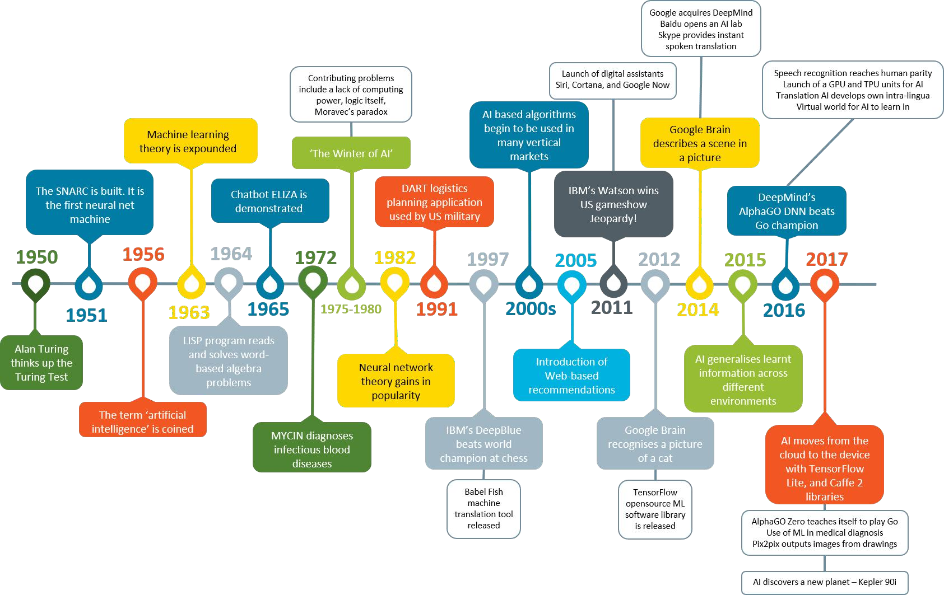
Timeline of Machine Learning
Soumedhik Bharati- soumedhikbharati@gmail.com-

Slide 7
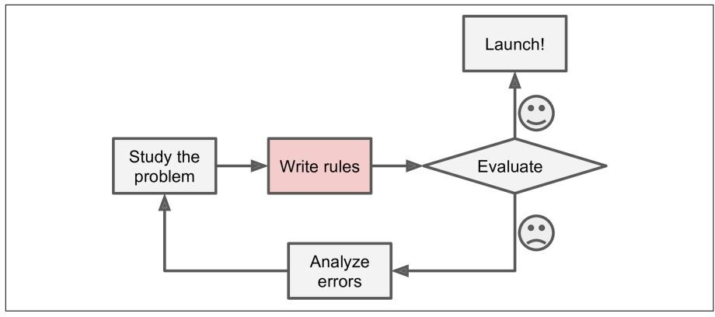
Why Use Machine Learning?
The traditional approach. If the problem is not trivial, your program will likely become a long list of complex rules pretty hard to maintain.
Soumedhik Bharati- soumedhikbharati@gmail.com-

Slide 8
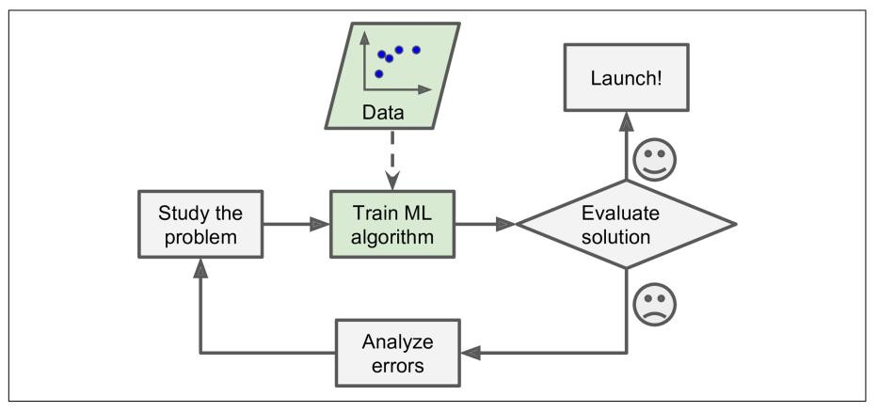
Why Use Machine Learning?
Machine Learning approach. The program is much shorter, easier to maintain, and most likely more accurate.
Soumedhik Bharati- soumedhikbharati@gmail.com-

Slide 9
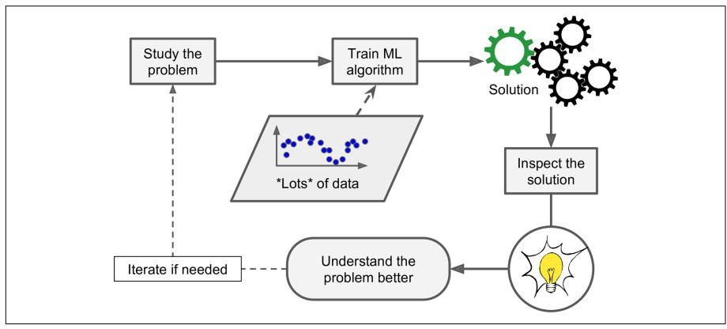
Why Use Machine Learning?
Machine Learning can help humans learn.
Soumedhik Bharati- soumedhikbharati@gmail.com-

Slide 10
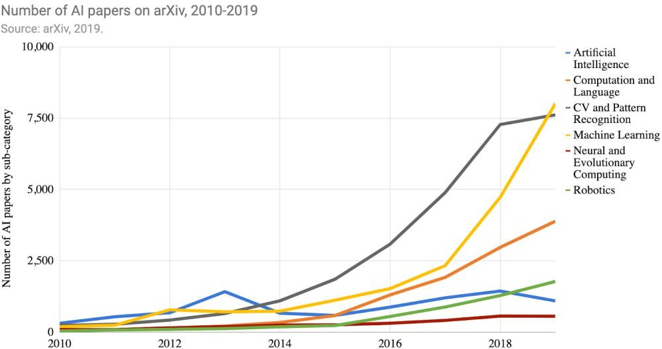
Why Use Machine Learning?
AI Index 2019 Annual Report.
Soumedhik Bharati- soumedhikbharati@gmail.com-

Slide 11
Applications of Machine Learning
Machine learning is currently the preferred approach in the following domains:
Speech analysis: e.g., speech recognition, synthesis.
Computer vision: e.g., object recognition/detection.
Robotics: e.g., position/map estimation.
Bio-informatics: e.g., sequence alignment, genetic analysis.
E-commerce: e.g., automatic trading, fraud detection.
Financial analysis: e.g., portfolio allocation, credits.
Medicine: e.g., diagnosis, therapy conception.
Web: e.g., Content management, social networks, etc.
Soumedhik Bharati- soumedhikbharati@gmail.com-

Slide 12
Applications of Machine Learning
To summarize, Machine Learning is great for:
Problems for which existing solutions require a lot of hand-tuning or long lists of rules: one Machine Learning algorithm can often simplify code and perform better.
Complex problems for which there is no good solution at all using a traditional approach: the best Machine Learning techniques can find a solution.
Soumedhik Bharati- soumedhikbharati@gmail.com-

Slide 13
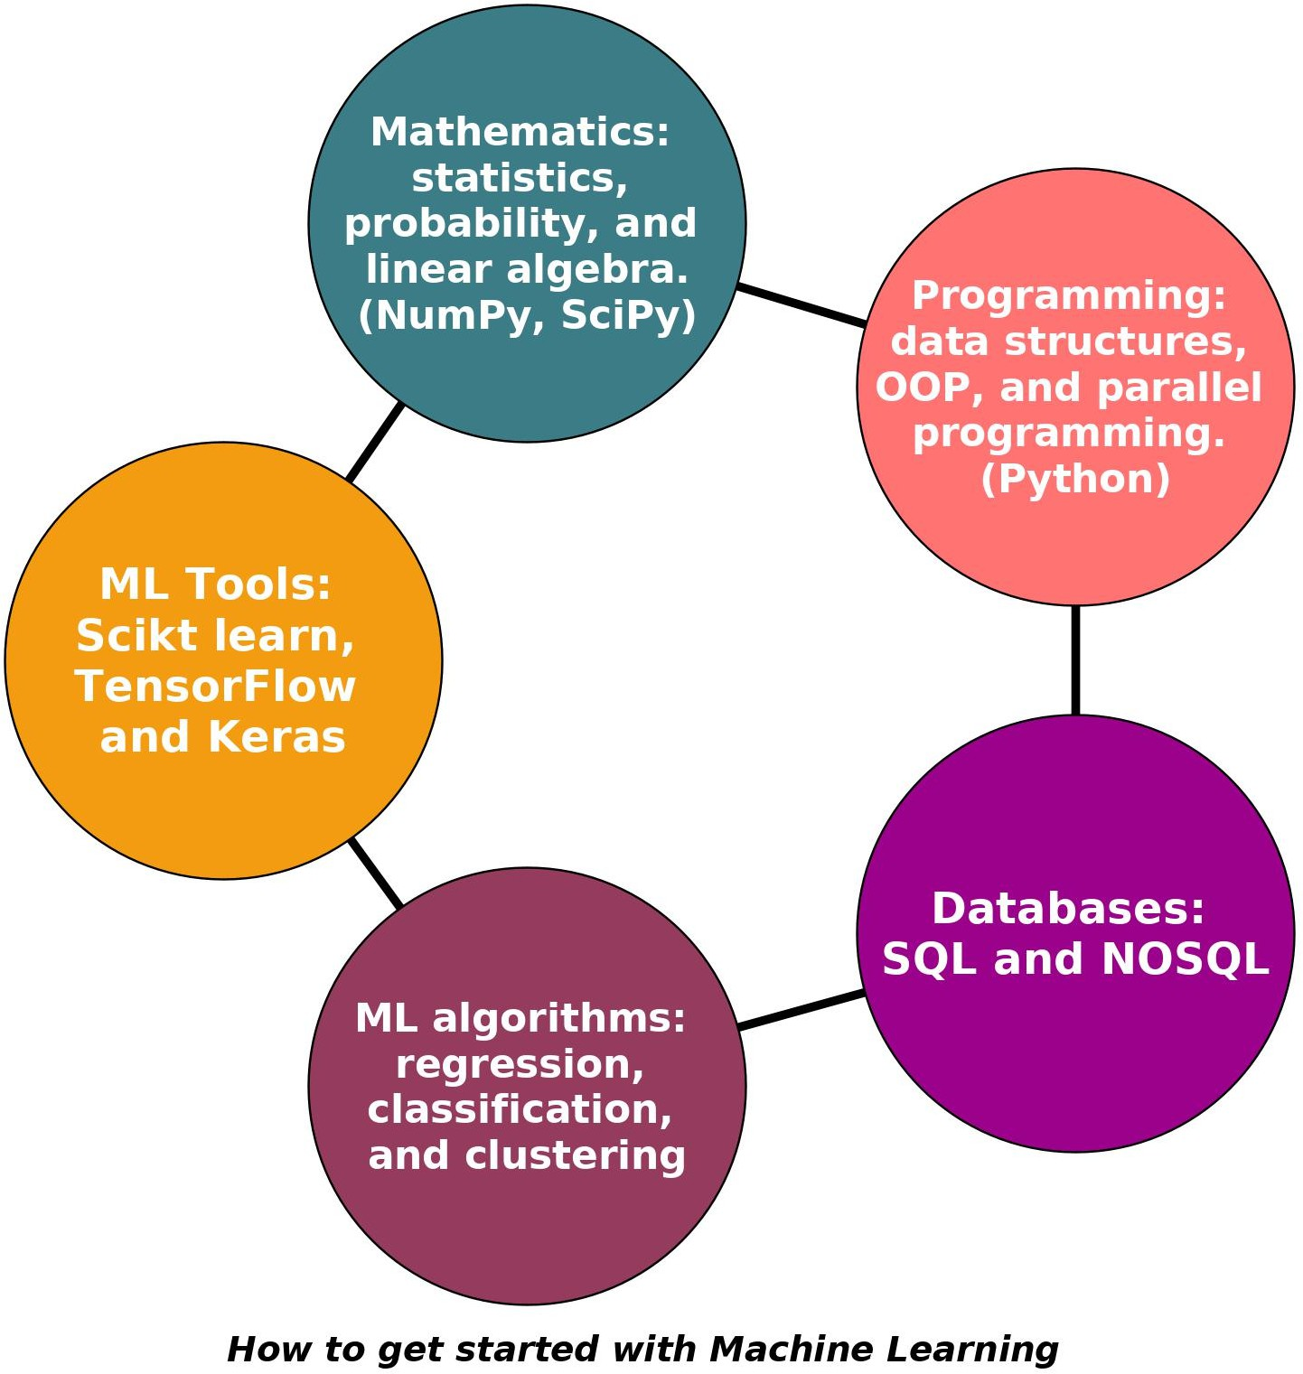
How to get started with ML
Mathematics: statistics, probability, and
linear algebra.(NumPy, SciPy)
Programming: data structures, OOP, and parallel programming. (Python)
Databases: SQL and NOSQL.
ML algorithms: regression, classification, and clustering.
ML Tools: Scikt learn, TensorFlow and Keras.
Soumedhik Bharati- soumedhikbharati@gmail.com-

Slide 14
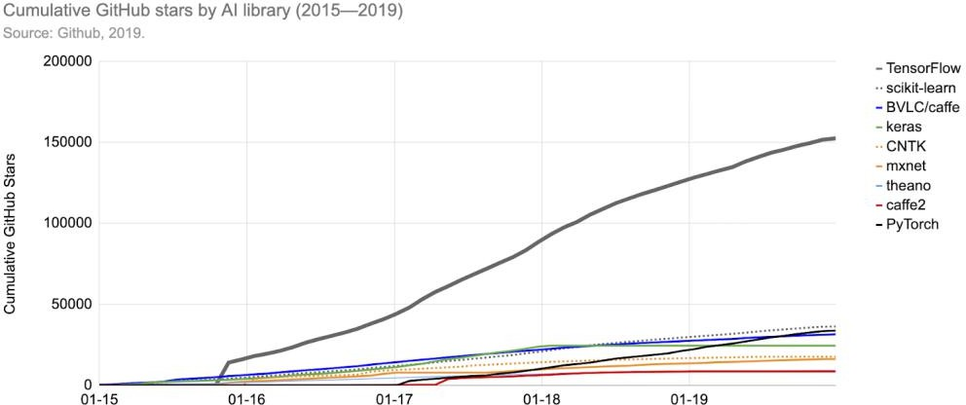
How to get started with ML
Soumedhik Bharati- soumedhikbharati@gmail.com-

Slide 15
Machine Learning Vocabulary 1
1) Examples: Items or instances of data used for learning or evaluation. In our spam problem, these examples correspond to the collection of email messages we will use for learning and testing.
2) Training sample: Examples used to train a learning algorithm. In our spam problem, the training sample consists of a set of email examples along with their associated labels.
3) Labels: Values or categories assigned to examples. In classification problems, examples are assigned specific categories, for instance, the spam and non-spam categories in our binary classification problem. In regression, items are assigned real-valued labels.
Soumedhik Bharati- soumedhikbharati@gmail.com-

Slide 16
Machine Learning Vocabulary 2
4) Features: The set of attributes, often represented as a vector, associated to an example. In the case of email messages, some relevant features may include the length of the message, the name of the sender, various characteristics of the header, the presence of certain keywords in the body of the message, and so on.
5) Test sample: Examples used to evaluate the performance of a learning algorithm. The test sample is separate from the training and validation data and is not made available in the learning stage. In the spam problem, the test sample consists of a collection of email examples for which the learning algorithm must predict labels based on features. These predictions are then compared with the labels of the test sample to measure the performance of the algorithm.
6) Loss function: A function that measures the difference, or loss, between a predicted label and a true label.
Soumedhik Bharati- soumedhikbharati@gmail.com-

Slide 17
Types of Machine Learning Systems
There are so many different types of Machine Learning systems that it is useful to classify them in broad categories based on:
Whether or not they are trained with human supervision (supervised, unsupervised, semisupervised, and Reinforcement Learning).
Whether or not they can learn incrementally on the fly (online versus batch learning).
Whether they work by simply comparing new data points to known data points, or instead detect patterns in the training data and build a predictive model, much like scientists do (instance-based versus model- based learning).
Soumedhik Bharati- soumedhikbharati@gmail.com-

Slide 18
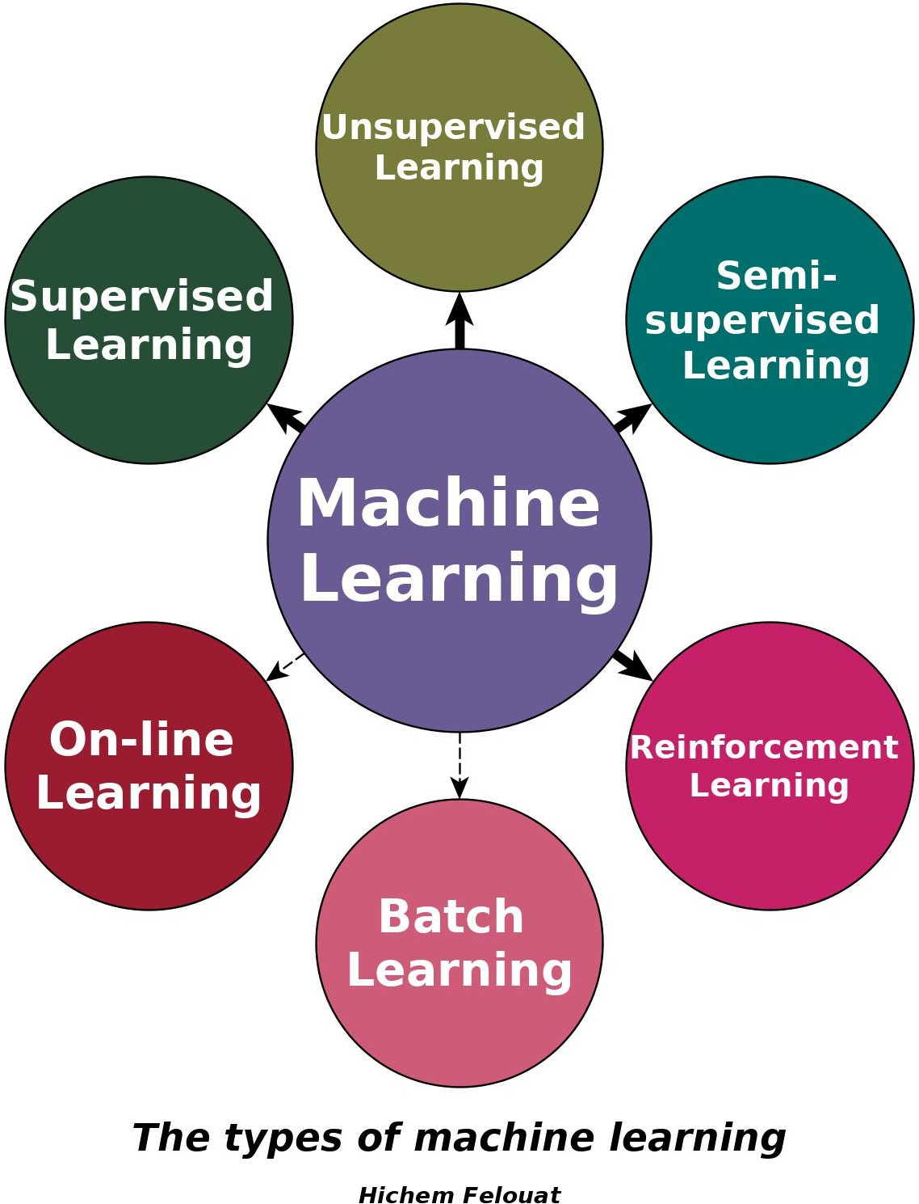
Types of Machine Learning Systems
Soumedhik Bharati- soumedhikbharati@gmail.com-

Slide 19
Types of Machine Learning Systems
Supervised learning :
In supervised learning, the training data you feed to the algorithm includes the desired solutions, called labels.
When y is real, we talk about regression.
When y is discrete, we talk about classification.
Soumedhik Bharati- soumedhikbharati@gmail.com-

Slide 20
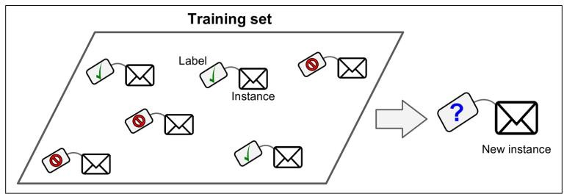
Types of Machine Learning Systems
A labeled training set for supervised learning.
Soumedhik Bharati- soumedhikbharati@gmail.com-

Slide 21
Types of Machine Learning Systems
Here are some of the most important supervised learning algorithms:
k-Nearest Neighbors
Linear Regression
Logistic Regression
Support Vector Machines (SVMs)
Decision Trees and Random Forests
Neural networks*
Soumedhik Bharati- soumedhikbharati@gmail.com-

Slide 22
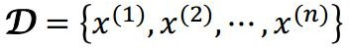
Types of Machine Learning Systems
Unsupervised Learning:
In unsupervised learning, as you might guess, the training data is unlabeled. The system tries to learn without a teacher.
No labels are given to the learning algorithm, leaving it on its own to explore or find structure in the data.
Soumedhik Bharati- soumedhikbharati@gmail.com-

Slide 23
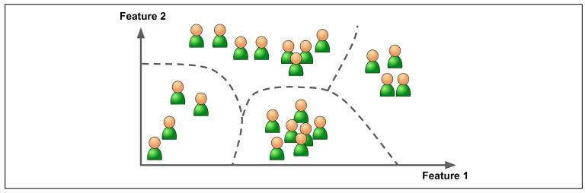
Types of Machine Learning Systems
An unlabeled training set for unsupervised learning.
Soumedhik Bharati- soumedhikbharati@gmail.com-

Slide 24
Types of Machine Learning Systems
Here are some of the most important unsupervised learning algorithms:
Clustering
Visualization and dimensionality reduction
Soumedhik Bharati- soumedhikbharati@gmail.com-

Slide 25
Types of Machine Learning Systems
Semi-Supervised Learning :
Some algorithms can deal with partially labeled training data, usually a lot of unlabeled data and a little bit of labeled data. This is called semi-supervised learning.
Most semi-supervised learning algorithms are combinations of unsupervised and supervised algorithms.
Soumedhik Bharati- soumedhikbharati@gmail.com-

Slide 26
Types of Machine Learning Systems
Reinforcement Learning :
The learning system called an agent in this context.
Can observe the environment, select and perform actions, and get rewards in return (or penalties in the form of negative rewards).
It must then learn by itself what is the best strategy, called a policy, to get the most reward over time.
A policy defines what action the agent should choose when it is in a given situation.
Soumedhik Bharati- soumedhikbharati@gmail.com-

Slide 27
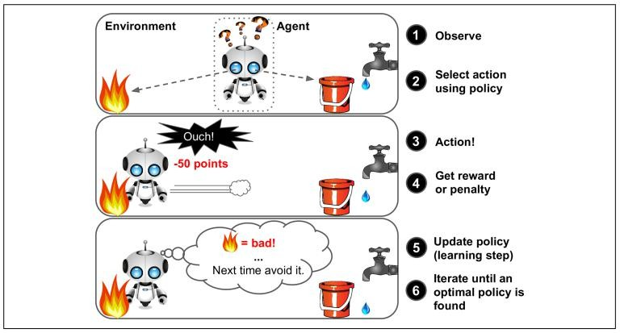
Types of Machine Learning Systems
Reinforcement Learning
Soumedhik Bharati- soumedhikbharati@gmail.com-

Slide 28
Types of Machine Learning Systems
Batch learning:
In batch learning, the system is incapable of learning incrementally: it must be trained using all the available data. This will generally take a lot of time and computing resources, so it is typically done offline. First, the system is trained, and then it is launched into production and runs without learning anymore; it just applies what it has learned. This is called offline learning.
Soumedhik Bharati- soumedhikbharati@gmail.com-

Slide 29
Types of Machine Learning Systems
On-line learning:
In online learning, you train the system incrementally by feeding it data instances sequentially, either individually or by small groups called mini batches. Each learning step is fast and cheap, so the system can learn about new data on the fly, as it arrives.
Soumedhik Bharati- soumedhikbharati@gmail.com-

Slide 30
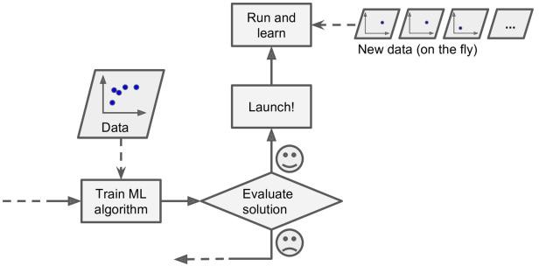
Types of Machine Learning Systems
Soumedhik Bharati- soumedhikbharati@gmail.com-

Slide 31
Instance-Based VS Model-Based Learning
One more way to categorize Machine Learning systems is by how they generalize. Most Machine Learning tasks are about making predictions. This means that given a number of training examples, the system needs to be able to generalize to examples it has never seen before.
Having a good performance measure on the training data is good, but insufficient; the true goal is to perform well on new instances. There are two main approaches to generalization: instance-based learning and model-based learning.
Soumedhik Bharati- soumedhikbharati@gmail.com-

Slide 32
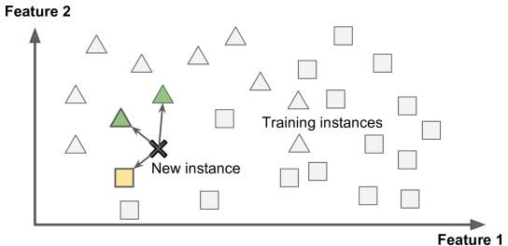
Instance-Based VS Model-Based Learning
Instance-based learning:
The system learns the examples by heart, then generalizes to new cases using a similarity measure.
Soumedhik Bharati- soumedhikbharati@gmail.com-

Slide 33
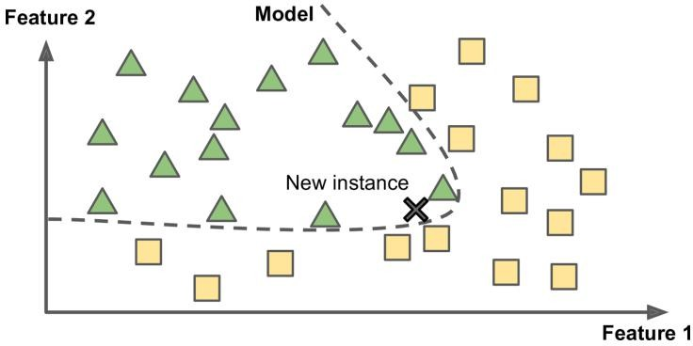
Instance-Based VS Model-Based Learning
Model-based learning:
Build a model of these examples, then use that model to make predictions.
Soumedhik Bharati- soumedhikbharati@gmail.com-

Slide 34
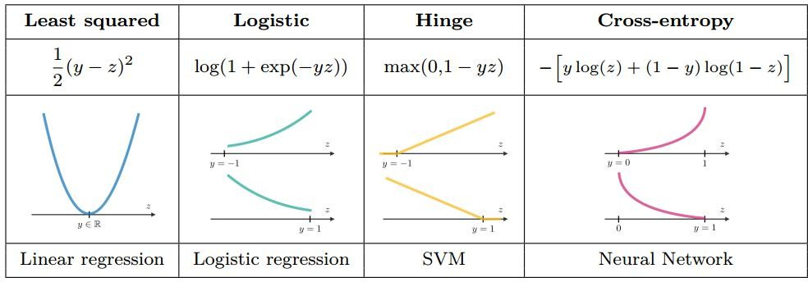
Loss Function
The loss function computes the error for a single training example, while the cost function is the average of the loss functions of the entire training set.
Soumedhik Bharati- soumedhikbharati@gmail.com-

Slide 35
Machine Learning Vocabulary 3
Hyperparameters : are configuration variables that are external to the model and whose values cannot be estimated from data. That is to say, they can not be learned directly from the data in standard model training. They are almost always specified by the machine learning engineer prior to training.
Regression: this is the problem of predicting a real value for each item. Examples of regression include prediction of stock values or that of variations of economic variables.
Classification: this is the problem of assigning a category to each item.
Clustering: this is the problem of partitioning a set of i tems into homogeneous subsets.
Soumedhik Bharati- soumedhikbharati@gmail.com-

Slide 36
In Summary
You studied the data.
You selected a model.
You trained it on the training data.
Finally, you applied the model to make predictions on new cases.
Soumedhik Bharati- soumedhikbharati@gmail.com-

Slide 37
Main Challenges of Machine Learning
In short, since your main task is to select a learning algorithm and train it on some data, the two things that can go wrong are “bad data” and “bad algorithm”.
Soumedhik Bharati- soumedhikbharati@gmail.com-

Slide 38
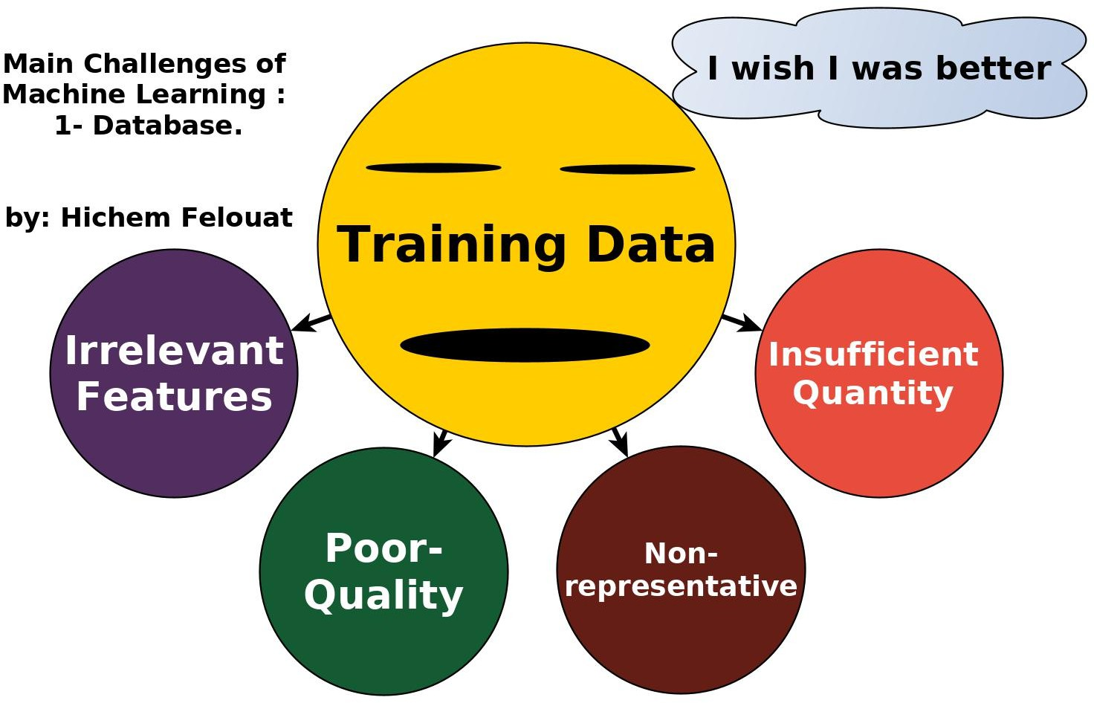
Main Challenges of Machine Learning 1- Database
Soumedhik Bharati- soumedhikbharati@gmail.com-

Slide 39
Main Challenges of Machine Learning 1- Database
1- Insufficient Quantity of Training Data :
Machine Learning takes a lot of data for most Machine Learning algorithms to work properly. Even for very simple problems you typically need thousands of examples, and for complex problems such as image or speech recognition you may need millions of examples (unless you can reuse parts of an existing model).
Soumedhik Bharati- soumedhikbharati@gmail.com-

Slide 40
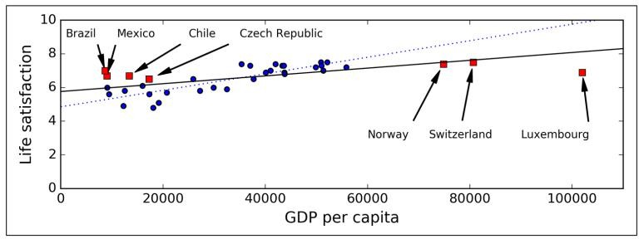
Main Challenges of Machine Learning 1- Database
2) Non-representative Training Data:
In order to generalize well, it is crucial that your training data be representative of the new cases you want to generalize to. This is true whether you use instance- based learning or model-based learning.
Soumedhik Bharati- soumedhikbharati@gmail.com-

Slide 41
Main Challenges of Machine Learning 1- Database
3) Poor-Quality Data:
If your training data is full of errors, outliers, and noise ( e.g., due to poor quality measurements), it will make it harder for the system to detect the underlying patterns, so your system is less likely to perform well. It is often well worth the effort to spend time cleaning up your training data. The truth is, most data scientists spend a significant part of their time doing just that. For example:
If some instances are clearly outliers, it may help to simply discard them or try to fix the errors manually.
If some instances are missing a few features (e.g., 5% of your customers did not specify their age), you must decide whether you want to ignore this attribute altogether, ignore these instances, fill in the missing values (e.g., with the median age), or train one model with the feature and one model without it, and so on.
Soumedhik Bharati- soumedhikbharati@gmail.com-

Slide 42
Main Challenges of Machine Learning 1- Database
Irrelevant Features:
Your system will only be capable of learning if the training data contains enough relevant features and not too many irrelevant ones. A critical part of the success of a Machine Learning project is coming up with a good set of features to train on. This process, called feature engineering, involves:
Feature selection: selecting the most useful features to train on among existing features.
Feature extraction: combining existing features to produce a more useful one (dimensionality reduction algorithms can help).
Creating new features by gathering new data.
Soumedhik Bharati- soumedhikbharati@gmail.com-

Slide 43
Main Challenges of Machine Learning 2- Algorithm
1) Overfitting the Training Data:
Overfitting happens when a model learns the detail and noise in the training data to the extent that it negatively impacts the performance of the model on new data. This means that the noise or random fluctuations in the training data is picked up and learned as concepts by the model. The problem is that these concepts do not apply to new data and negatively impact the models ability to generalize.
The model performs well on the training data, but it does not generalize well.
Soumedhik Bharati- soumedhikbharati@gmail.com-

Slide 44
Main Challenges of Machine Learning 2- Algorithm
2) Underfitting the Training Data:
Underfitting is the opposite of overfitting: it occurs when your model is too simple to learn the underlying structure of the data.
Soumedhik Bharati- soumedhikbharati@gmail.com-

Slide 45
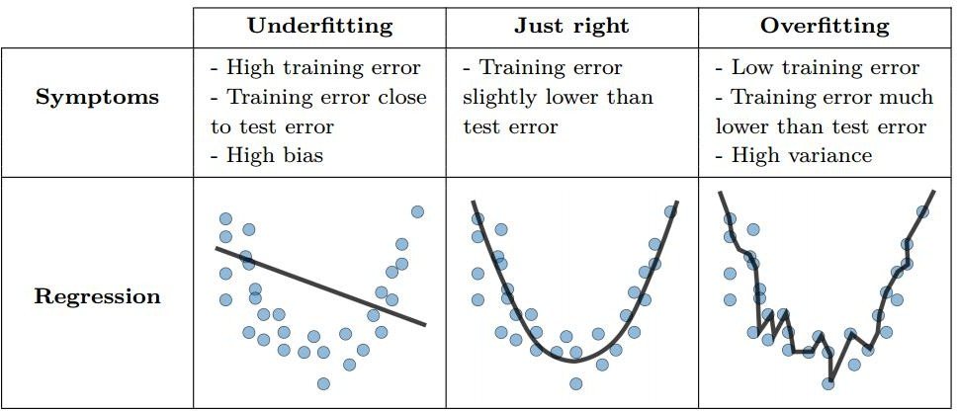
Main Challenges of Machine Learning 2- Algorithm
Soumedhik Bharati- soumedhikbharati@gmail.com-

Slide 46
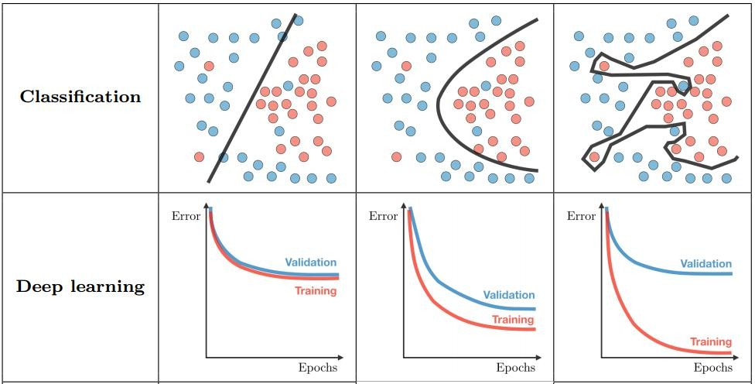
Main Challenges of Machine Learning 2- Algorithm
Soumedhik Bharati- soumedhikbharati@gmail.com-

Slide 47
How to Avoid Underfitting and Overfitting
Underfitting :
Complexify model
Add more features
Train longer
Overfitting :
validation
Perform regularization
Get more data
Remove/Add some features
Soumedhik Bharati- soumedhikbharati@gmail.com-

Slide 48
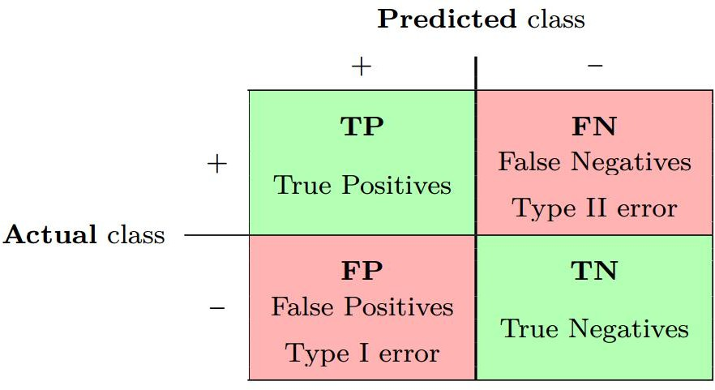
Common Classification Model Evaluation Metrics : Confusion Matrix
The confusion matrix is used to describe the performance of a classification model on a set of test data for which true values are known.
Soumedhik Bharati- soumedhikbharati@gmail.com-

Slide 49
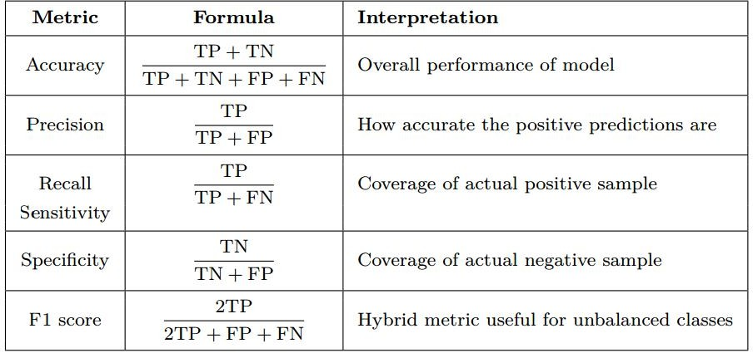
Common Classification Model Evaluation metrics : Main Metrics
Soumedhik Bharati- soumedhikbharati@gmail.com-

Slide 50
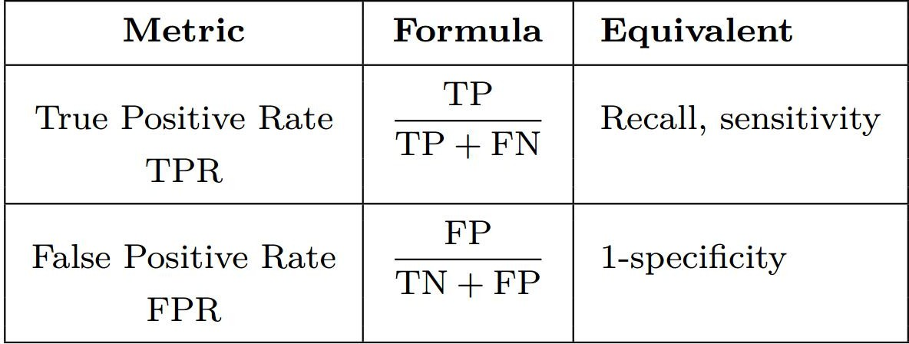
Common Classification Model Evaluation metrics : Main Metrics
Soumedhik Bharati- soumedhikbharati@gmail.com-

Slide 51
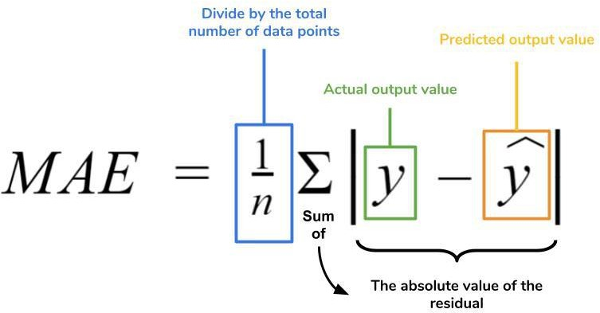
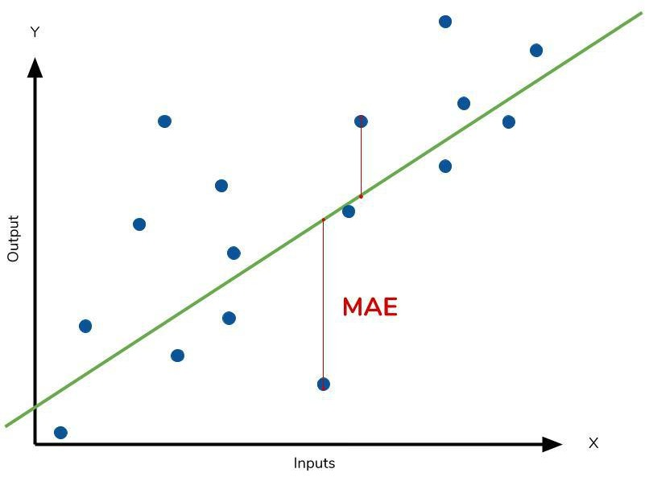
Common Regression Model Evaluation metrics : Mean Absolute Error
Soumedhik Bharati- soumedhikbharati@gmail.com-

Slide 52
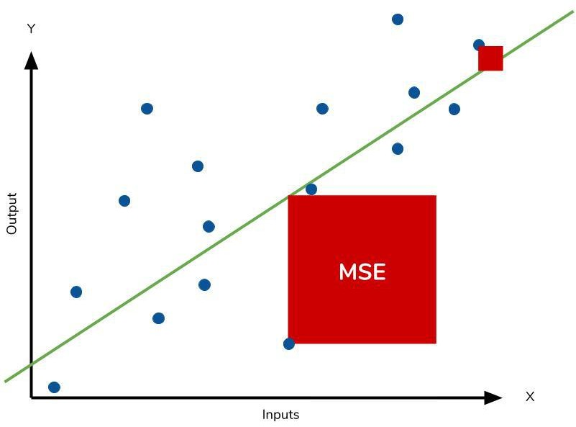
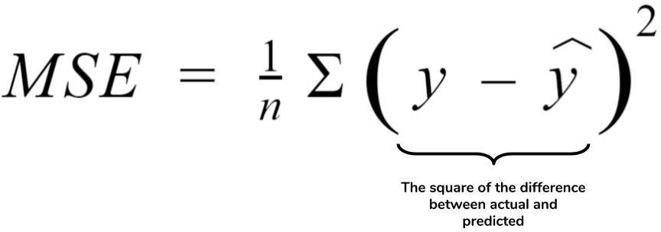
Common Regression Model Evaluation metrics : Mean Square Error
Soumedhik Bharati- soumedhikbharati@gmail.com-

Slide 53
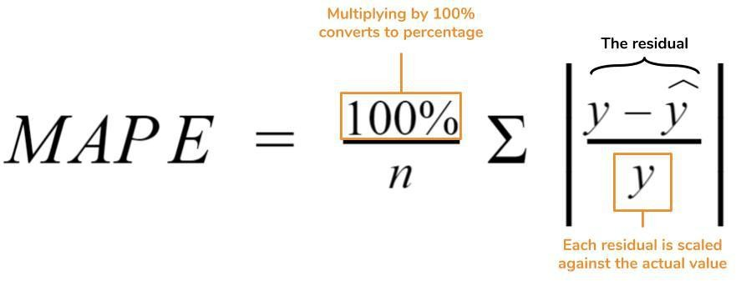
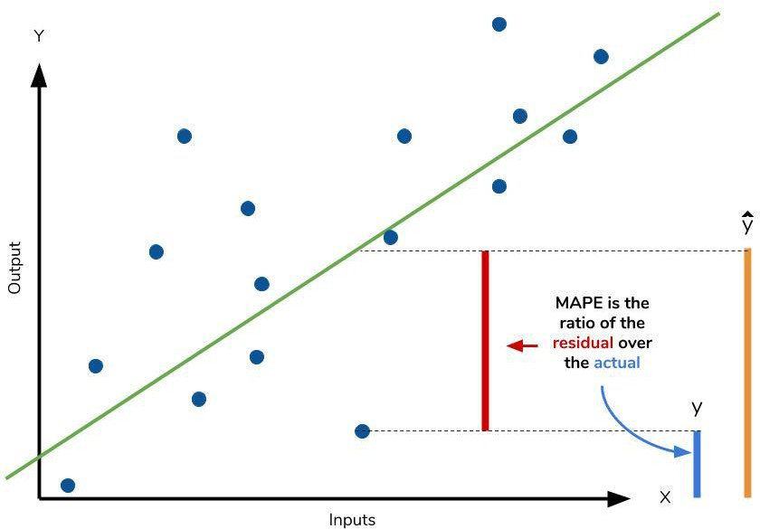
Common Regression Model Evaluation metrics : Mean Absolute Percentage Error
Soumedhik Bharati- soumedhikbharati@gmail.com-

Slide 54
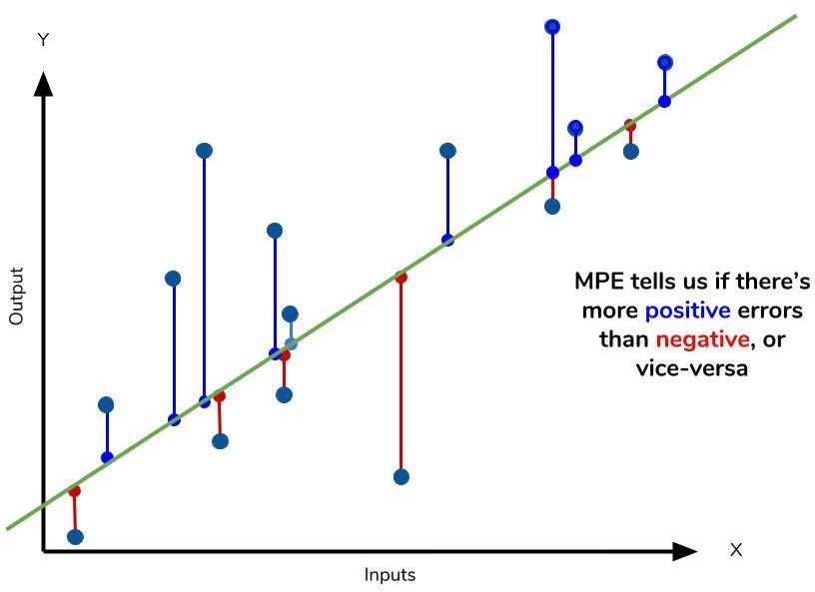
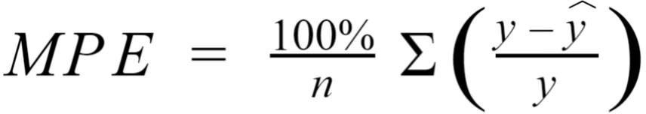
Common Regression Model Evaluation metrics : Mean Percentage Error
Soumedhik Bharati- soumedhikbharati@gmail.com-

Slide 55
Testing and Validating
It is common to use 80% of the data for training and hold out 20% for testing.
If the training error is low (i.e., your model makes few mistakes on the training set) but the generalization error is high, it means that your model is overfitting the training data.
A common solution to this problem is to have a second holdout set called the validation set. You train multiple models with various hyperparameters using the training set, you select the model and hyperparameters that perform best on the validation set, and when you’re happy with your model you run a single final test against the test set to get an estimate of the generalization error.
Soumedhik Bharati- soumedhikbharati@gmail.com-

Slide 56
Testing and Validating : Cross-Validation
Cross-Validation (CV) : the training set is split into complementary subsets, and each model is trained against a different combination of these subsets and validated against the remaining parts. Once the model type and hyperparameters have been selected, a final model is trained using these hyperparameters on the full training set, and the generalized error is measured on the test set.
Soumedhik Bharati- soumedhikbharati@gmail.com-

Slide 57
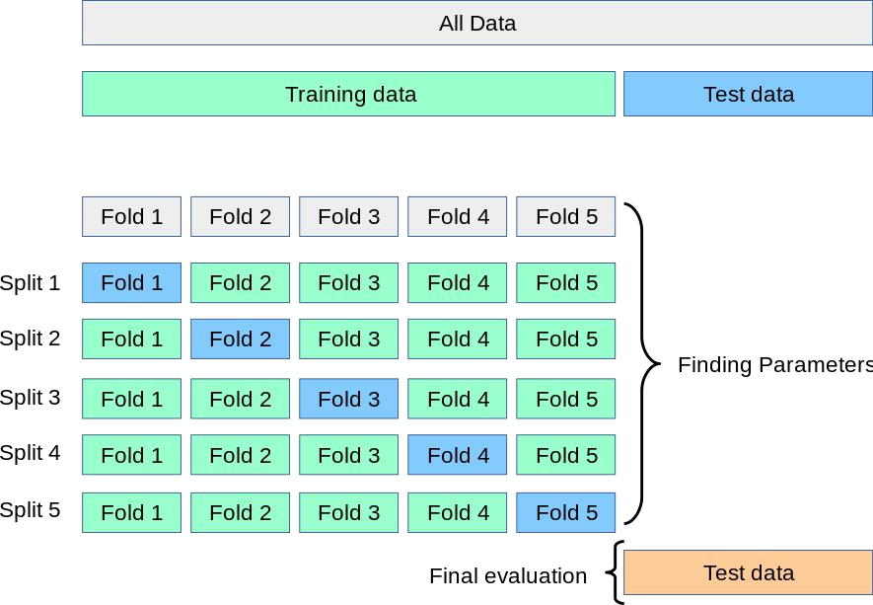
Testing and Validating : Cross-Validation
Soumedhik Bharati- soumedhikbharati@gmail.com-

Slide 58
Boosting
Boosting refers to any Ensemble method that can combine several weak learners into a strong learner. The general idea of most boosting methods is to train predictors sequentially, each trying to correct its predecessor. There are many boosting methods available, but by far the most popular are AdaBoost (Adaptive Boosting) and Gradient Boosting.
Soumedhik Bharati- soumedhikbharati@gmail.com-

Slide 59
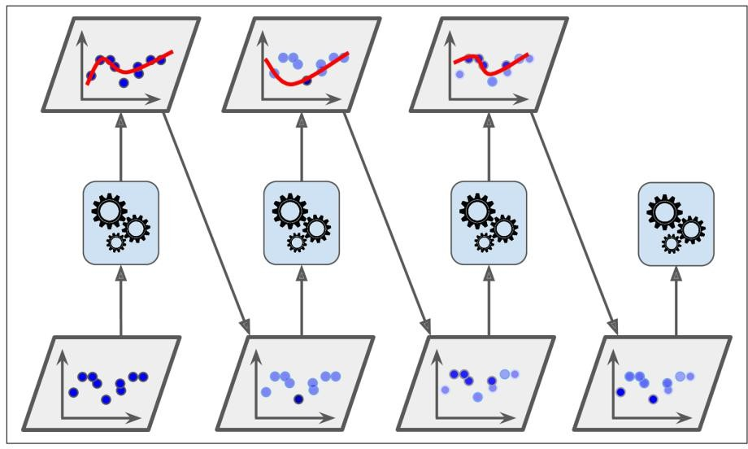
Boosting
AdaBoost sequential training with instance weight updates
Soumedhik Bharati- soumedhikbharati@gmail.com-

Slide 60
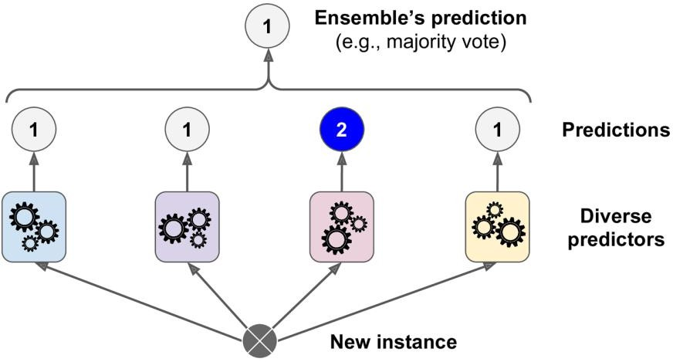
Voting Classifiers
The Voting Classifier: is a meta-classifier for combining similar or conceptually different machine learning classifiers for classification via majority or plurality voting. (For simplicity, we will refer to both majority and plurality voting as majority voting.)
Soumedhik Bharati- soumedhikbharati@gmail.com-

Slide 61
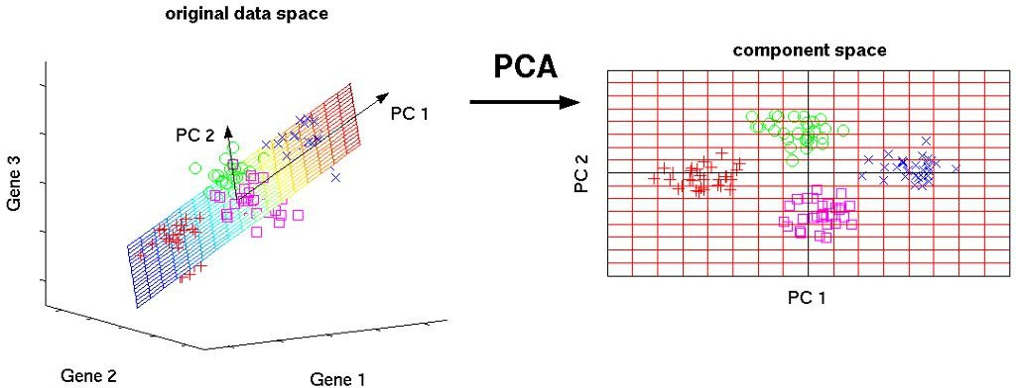
Dimensionality Reduction
Many Machine Learning problems involve thousands or even millions of features for each training instance. Not only does this make training extremely slow, but it can also make it much harder to find a good solution. This problem is often referred to as the curse of dimensionality.
Principal Component Analysis
Soumedhik Bharati- soumedhikbharati@gmail.com-

Slide 62
Hyperparameter Tuning
Hyperparameter Tuning : works by running multiple trials in a single training job. Each trial is a complete execution of your training application with values for your chosen hyperparameters, set within limits you specify. The AI Platform training service keeps track of the results of each trial and makes adjustments for subsequent trials. When the job is finished, you can get a summary of all the trials along with the most effective configuration of values according to the criteria you specify.
Soumedhik Bharati- soumedhikbharati@gmail.com-

Slide 63
Steps to Build a Machine Learning System
Data collection.
Improving data quality (data preprocessing).
Feature engineering (feature extraction and selection, dimensionality reduction).
Splitting data into training and evaluation sets.
Algorithm selection.
Training.
Evaluation + Hyperparameter tuning.
Testing.
Deployment
Soumedhik Bharati- soumedhikbharati@gmail.com-

Slide 64
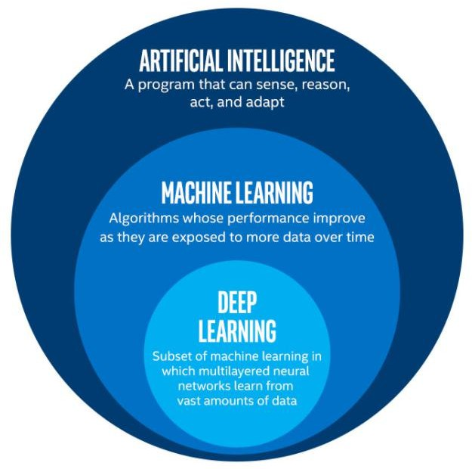
Deep Learning
Deep Learning is a subfield of machine learning concerned with algorithms inspired by the structure and function of the brain called artificial neural networks.
Soumedhik Bharati- soumedhikbharati@gmail.com-

Slide 65
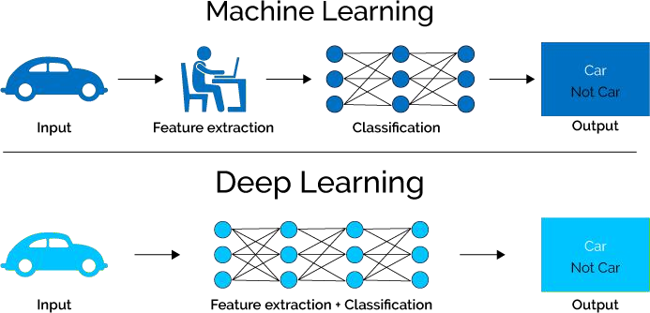
Deep Learning VS Machine Learning
Soumedhik Bharati- soumedhikbharati@gmail.com-

Slide 66
Feature extraction
Engineering of features is , however, a tedious process for several reasons: Takes a lot of time and Requires expert knowledge.
For learning-based applications, a lot of time is spent to adjust the features.
Extracted features often lack a structural representation reflecting
abstraction levels in the problem at hand.
Soumedhik Bharati- soumedhikbharati@gmail.com-

Slide 67
Representation learning
Deep Learning aims at learning automatically representations from large sets of labeled data:
The machine is powered with raw data.
Automatic discovery of representations.
Soumedhik Bharati- soumedhikbharati@gmail.com-

Slide 68
Deep learning models
Several DL models have been proposed :
Autoencoders (Aes)
Deep belief networks (DBNs)
Convolutional neural networks (CNNs).
Recurrent neural networks (RNNs).
Generative adversial networks (GANs), etc.
Soumedhik Bharati- soumedhikbharati@gmail.com-

Slide 69

Convolutional neural networks (CNNs)
Soumedhik Bharati- soumedhikbharati@gmail.com-

Slide 70
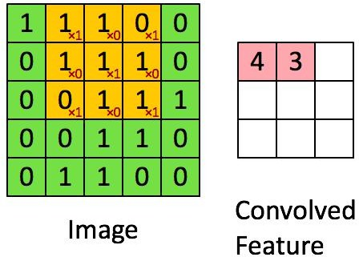
Convolutional neural networks (CNNs)
Soumedhik Bharati- soumedhikbharati@gmail.com-

Slide 71
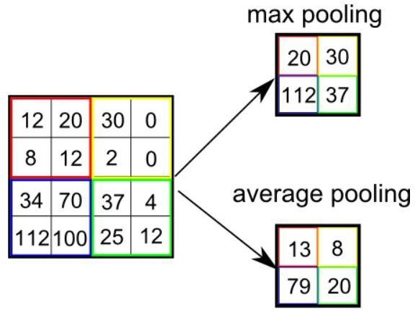
Convolutional neural networks (CNNs)
Soumedhik Bharati- soumedhikbharati@gmail.com-

Slide 72
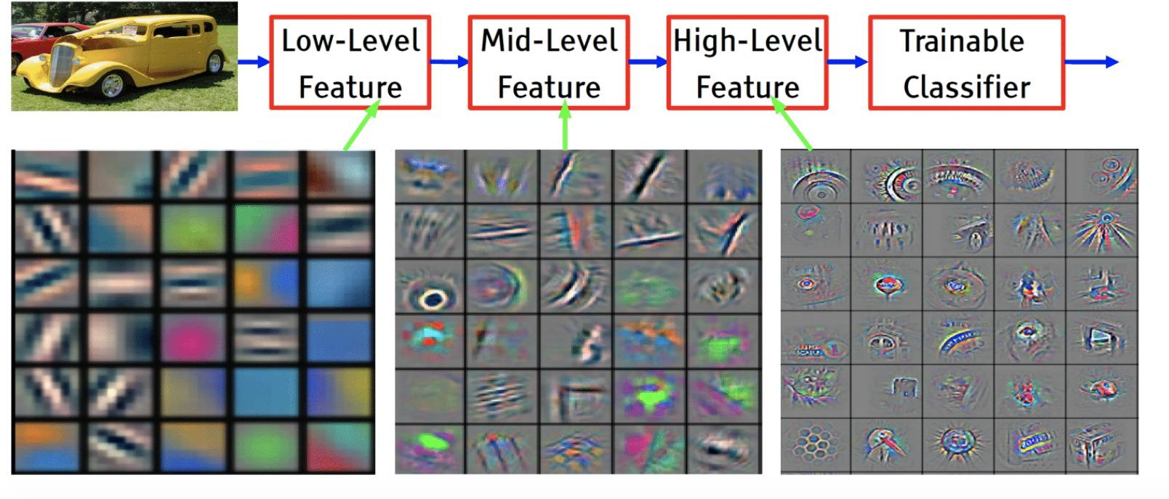
Convolutional neural networks (CNNs)
Soumedhik Bharati- soumedhikbharati@gmail.com-

Slide 73
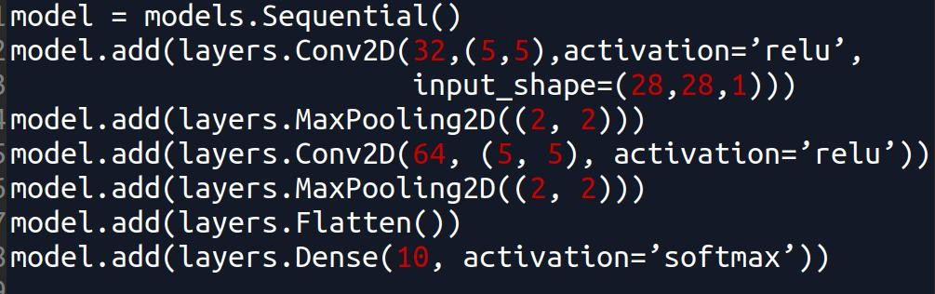
Convolutional neural networks (CNNs)
Soumedhik Bharati- soumedhikbharati@gmail.com-

Slide 74
Thank you for your attention!
Soumedhik Bharati- soumedhikbharati@gmail.com-

